Slide 1
Integration Test

Slide 2
Definition
Integration Testing is defined as a type of testing where software modules are integrated logically and tested as a group. A typical software project consists of multiple software modules, coded by different programmers. The purpose of this level of testing is to expose defects in the interaction between these software modules when they are integrated
Integration Testing focuses on checking data communication amongst these modules. Hence it is also termed as ‘I & T’ (Integration and Testing), ‘String Testing’ and sometimes ‘Thread Testing’.

Slide 3
Définition 2
Integration Test Case differs from other test cases in the sense it focuses mainly on the interfaces & flow of data/information between the modules. Here priority is to be given for the integrating links rather than the unit functions which are already tested.
Sample Integration Test Cases for the following scenario: Application has 3 modules say ‘Login Page’, ‘Mailbox’ and ‘Delete emails’ and each of them is integrated logically.
Here do not concentrate much on the Login Page testing as it’s already been done in Unit Testing. But check how it’s linked to the Mail Box Page.
Similarly Mail Box: Check its integration to the Delete Mails Module.

Slide 4
Test case of integration test
Test Case ID | Test Case Objective | Test Case Description | Expected Result
1 | Check the interface link between the Login and Mailbox module | Enter login credentials and click on the Login button | To be directed to the Mail Box
2 | Check the interface link between the Mailbox and Delete Mails Module | From Mailbox select the email and click a delete button | Selected email should appear in the Deleted/Trash folder

Slide 5
Types of Integration Testing
Software Engineering defines variety of strategies to execute Integration testing, viz.
Big Bang Approach :
Incremental Approach: which is further divided into the following
Top Down Approach
Bottom Up Approach
Sandwich Approach – Combination of Top Down and Bottom Up

Slide 6
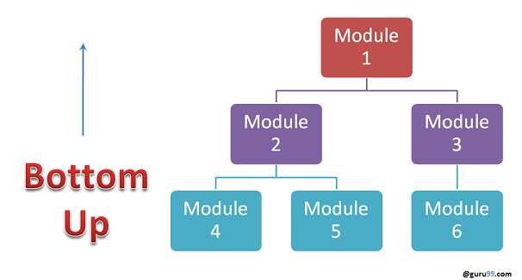
Bottom up I.T.
Advantages:
Fault localization is easier.
No time is wasted waiting for all modules to be developed unlike Big-bang approach
Disadvantages:
Critical modules (at the top level of software architecture) which control the flow of application are tested last and may be prone to defects.
An early prototype is not possible

Slide 7
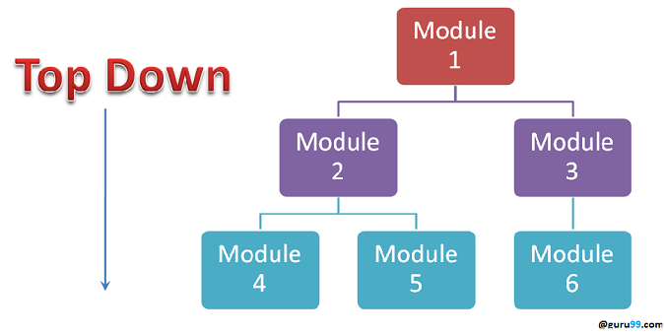
Top Down I.T.
Advantages:
Fault Localization is easier.
Possibility to obtain an early prototype.
Critical Modules are tested on priority; major design flaws could be found and fixed first.
Disadvantages:
Needs many Stubs.
Modules at a lower level are tested inadequately.

Slide 8
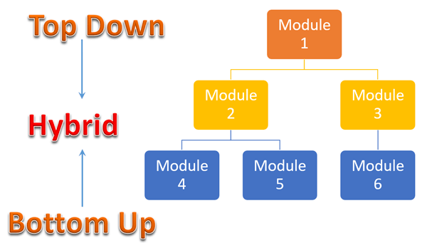
Sandwich Testing
Sandwich Testing is a strategy in which top level modules are tested with lower level modules at the same time lower modules are integrated with top modules and tested as a system. It is a combination of Top-down and Bottom-up approaches therefore it is called Hybrid Integration Testing. It makes use of both stubs as well as drivers.

Slide 9
How to do Integration Testing?
The Integration test procedure irrespective of the Software testing strategies (discussed above):
Prepare the Integration Tests Plan
Design the Test Scenarios, Cases, and Scripts.
Executing the test Cases followed by reporting the defects.
Tracking & re-testing the defects.
Steps 3 and 4 are repeated until the completion of Integration is successful.

Slide 10
Brief Description of Integration Test Plans
It includes the following attributes:
Methods/Approaches to testing (as discussed above).
Scopes and Out of Scopes Items of Integration Testing.
Roles and Responsibilities.
Pre-requisites for Integration testing.
Testing environment.
Risk and Mitigation Plans.

Slide 11
Entry and Exit Criteria of Integration Testing
Entry and Exit Criteria to Integration testing phase in any software development model
Entry Criteria:
Unit Tested Components/Modules
All High prioritized bugs fixed and closed
All Modules to be code completed and integrated successfully.
Integration tests Plan, test case, scenarios to be signed off and documented.
Required Test Environment to be set up for Integration testing
Exit Criteria:
Successful Testing of Integrated Application.
Executed Test Cases are documented
All High prioritized bugs fixed and closed
Technical documents to be submitted followed by release Notes.

Slide 12
Best Practices/ Guidelines for Integration Testing
First, determine the Integration Test Strategy that could be adopted and later prepare the test cases and test data accordingly.
Study the Architecture design of the Application and identify the Critical Modules. These need to be tested on priority.
Obtain the interface designs from the Architectural team and create test cases to verify all of the interfaces in detail. Interface to database/external hardware/software application must be tested in detail.
After the test cases, it’s the test data which plays the critical role.
Always have the mock data prepared, prior to executing. Do not select test data while executing the test cases.

